Slide 1
PBJ SCORING METHODOLOGY AND WQIP USE
REVIEW
Orange County Association of Health Facilities
September 13, 2023

Slide 2
Metrics & scoring
DHCS will calculate a raw WQIP score between 0 and 100 for each facility,
These are broken down as follows:

Slide 3
Staffing Percentiles
Description | Percentile | Category | Points
25th Percentile 4Q Avg. Adj CNA HPPD | 2.264 | CNA | 1
32.5th Percentile 4Q Avg. Adj CNA HPPD | 2.387 | CNA | 2
50th Percentile 4Q Avg. Adj CNA HPPD | 2.488 | CNA | 3
62.5th Percentile 4Q Avg. Adj CNA HPPD | 2.588 | CNA | 4
75th Percentile 4Q Avg. Adj CNA HPPD | 2.730 | CNA | 5
90th Percentile 4Q Avg. Adj CNA HPPD | 3.043 | CNA | 6
Description | Percentile | Category | Points
25th Percentile 4Q Avg. Adj LVN HPPD | 0.987 | LVN | 1
32.5th Percentile 4Q Avg. Adj LVN HPPD | 1.068 | LVN | 2
50th Percentile 4Q Avg. Adj LVN HPPD | 1.146 | LVN | 3
62.5th Percentile 4Q Avg. Adj LVN HPPD | 1.243 | LVN | 4
75th Percentile 4Q Avg. Adj LVN HPPD | 1.352 | LVN | 5
90th Percentile 4Q Avg. Adj LVN HPPD | 1.613 | LVN | 6
Description | Percentile | Category | Points
25th Percentile 4Q Avg. Adj RN HPPD | 0.369 | RN | 1
32.5th Percentile 4Q Avg. Adj RN HPPD | 0.431 | RN | 2
50th Percentile 4Q Avg. Adj RN HPPD | 0.491 | RN | 3
62.5th Percentile 4Q Avg. Adj RN HPPD | 0.571 | RN | 4
75th Percentile 4Q Avg. Adj RN HPPD | 0.663 | RN | 5
90th Percentile 4Q Avg. Adj RN HPPD | 0.963 | RN | 6
Description | Percentile | Category | Points
25th Percentile 4Q Avg. Adj Total HPPD | 3.858 | Total | 1
32.5th Percentile 4Q Avg. Adj Total HPPD | 4.019 | Total | 2
50th Percentile 4Q Avg. Adj Total HPPD | 4.158 | Total | 3
62.5th Percentile 4Q Avg. Adj Total HPPD | 4.327 | Total | 4
75th Percentile 4Q Avg. Adj Total HPPD | 4.547 | Total | 5
90th Percentile 4Q Avg. Adj Total HPPD | 5.241 | Total | 6
Description | Percentile | Category | Points
25th Percentile 4Q Avg. Adj Total Weekend HPPD | 3.451 | Total Weekend | 1
32.5th Percentile 4Q Avg. Adj Total Weekend HPPD | 3.612 | Total Weekend | 2
50th Percentile 4Q Avg. Adj Total Weekend HPPD | 3.753 | Total Weekend | 3
62.5th Percentile 4Q Avg. Adj Total Weekend HPPD | 3.912 | Total Weekend | 4
75th Percentile 4Q Avg. Adj Total Weekend HPPD | 4.092 | Total Weekend | 5
90th Percentile 4Q Avg. Adj Total Weekend HPPD | 4.733 | Total Weekend | 6

Slide 4
WQIP scoring summary
Points are weighted based on the category
Most weighting to staffing metrics
Awaiting further details from DHCS on weighting methodology

Slide 5
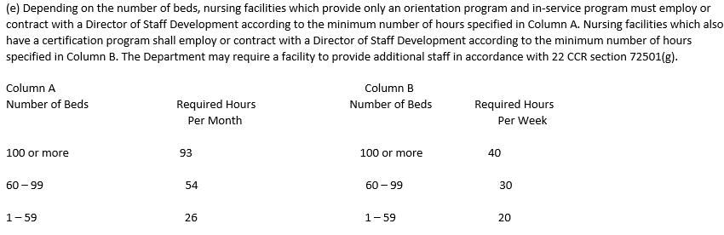
PBJ impacts & strategies
PPDs are determined using the PBJ data and scoring from CMS 5-star staffing
Opportunities to verify all staffing is being captured:
  Home office/Corporate/Resource hours allocation
  Agency/Registry staffing hours reporting
DSD Hours – direct care hours above the State requirements (below) can be classed to RN/LVN job codes
Hours classified to direct care MUST have a 530 in place to be used for CA staffing audits

Slide 6
PBJ impacts & strategies
Salaried Nurses – hours for PPD calculation are limited to 40 per week
  Consider moving from salary to hourly
  Consider moving some nursing staff to Tues-Sat or Sun-Thursday to increase weekend hours (both salary & hourly)
Discharge MDS – different from PCC census discharges
  Not completing discharge MDS can inflate your census days and lower your PPD #’s

Slide 7
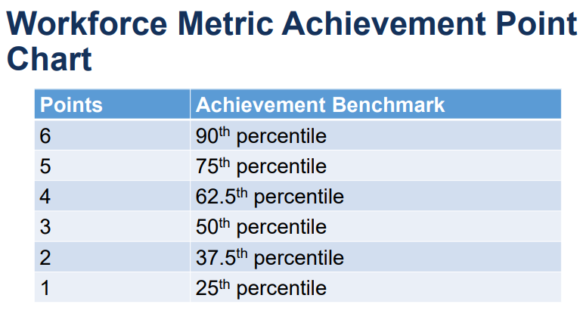
Staffing turnover
Follows CMS methodology for turnover
Points earned based on facility percentile ranking
Baseline Period for percentile from 1/1/21 – 6/30/22
Measurement period will be 4/1/22 – 9/30/23
Based on gaps in days worked
Workers who worked 120 hours in the qualifying period at a facility will be in the denominator
  Includes registry/agency workers and Home office/Corporate/Resource staff
  Qualifying period is 90-day period starting from April 1, 2022 – December 31, 2022
Gap is determined as no hours worked in a 60-day period from July 1, 2022 – Sept 30, 2023
Need to monitor 60-day gaps up to September 30 and 60 days beyond.

Slide 8
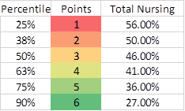
Staffing turnover
Percentile ranks

Slide 9
Calculation used for staffing hours
Still using RUGS IV for expected staffing hour case mix adjustment
  Staffing calculation: (Actual hours PPD / Expected hours PPD) X National Average Hrs PPD = Adjusted Hours PPD
  VERY IMPORTANT NOTE FOR CMI STATES: Because of the use of the indexing, if your CMI increases for rate purposes, but your staffing remains the same, could have negative effect on star ratings
Quarterly Calculation of Staffing hours
Uses TOTAL hours reported per quarter divided by TOTAL reported census to arrive at actual hours PPD for calculation above
Important to note: PBJ is separate and distinct from any state staffing requirements and counting rules.
The reported hours are those reported by the facility through PBJ as described above. National average hours for a given staff type represent the national mean of case-mix hours across all facilities active on the last day of the quarter that submitted valid nurse staffing data for the quarter. The National Average Hours are updated every quarter and will be available in the state averages table at: https://data.medicare.gov/data/nursing-home-compare.

Slide 10
Summary of PBJ scoring methodology
PBJ is now a system of points ratings, with a total possible of 380 points.
There are now a total of 6 measures: PPD’s for RN, overall nursing, and overall nursing weekend, and turnover for RN, nursing overall, and Administrator.
Below are the cut points for the new star ratings.
1 star 2 stars 3 stars 4 stars 5 stars
< 155 156 - 204 205 - 254 255 - 319 320 - 380

Slide 11
Nursing staffing hours measurement and scoring
Nursing staffing still includes RN and overall, but now includes overall for weekends for a 3rd measure.
PPD calculation is no different than it has been, Adjusted Hours = (Hours Reported/Hours Case-Mix) * Hours National Average
Instead of 5 tier star rating for each, is now points. RN and overall have possible 100 points each, awarded in increments of 10, and weekend possible 50 points, in increments of 5, for total possible of 250, essentially 2/3 of possible total.
The deciles used are based on the national distribution of adjusted hours PPD.

Slide 12
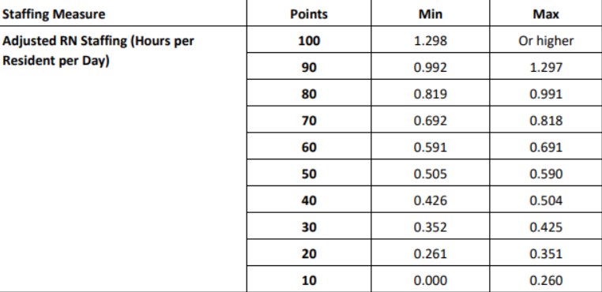
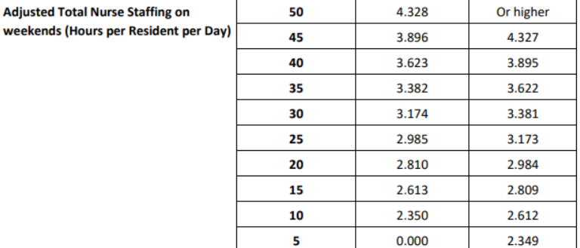
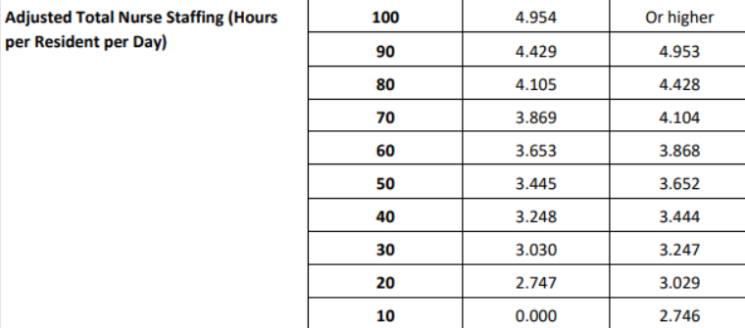
Deciles for staffing points

Slide 13
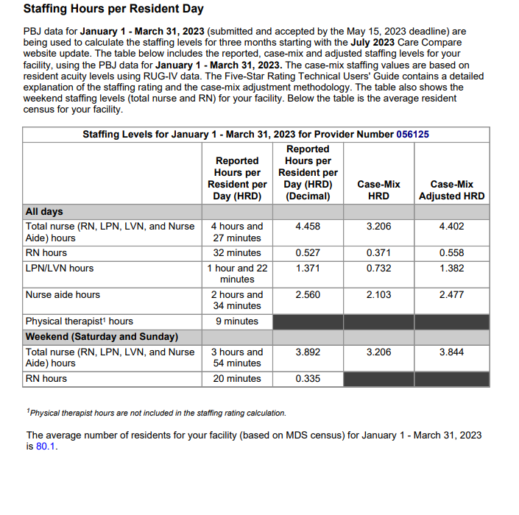
CMS Five Star report staffing sample

Slide 14
Turnover measurement and scoring
Turnover points available are 130, with RN and overall nursing having possible 50 points each, awarded in increments of 5, and Administrator having possible of 30, with 30 for no changes, 25 for one, and 10 for two or more.
Deciles used are based on the national distribution of turnover percentages.
The measurement period is the 12 months prior to the quarter being rated. For the ratings for the 3rd Q 2023, the turnover is based on four quarters from July 2022-June 2023.

Slide 15
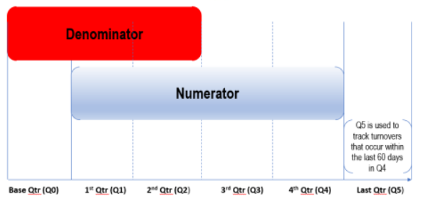
Turnover measurement and scoring
Employees tracked (denominator): Those who, between 1st day of quarter preceding measurement period (April, 2022 for 3rd Q 2023 scoring) through Dec. 31, 2022, and worked at least 120 hours in any 90 day period in this April 22-Dec 22 period.
Employees considered no longer working (numerator): Any tracked employee from above who has a 60 consecutive day period of not working, between July 1, 2022 and August 30, 2023.
Numerator div. by Denominator = turnover percentage in that category, and then points awarded based on decile ranking.

Slide 16
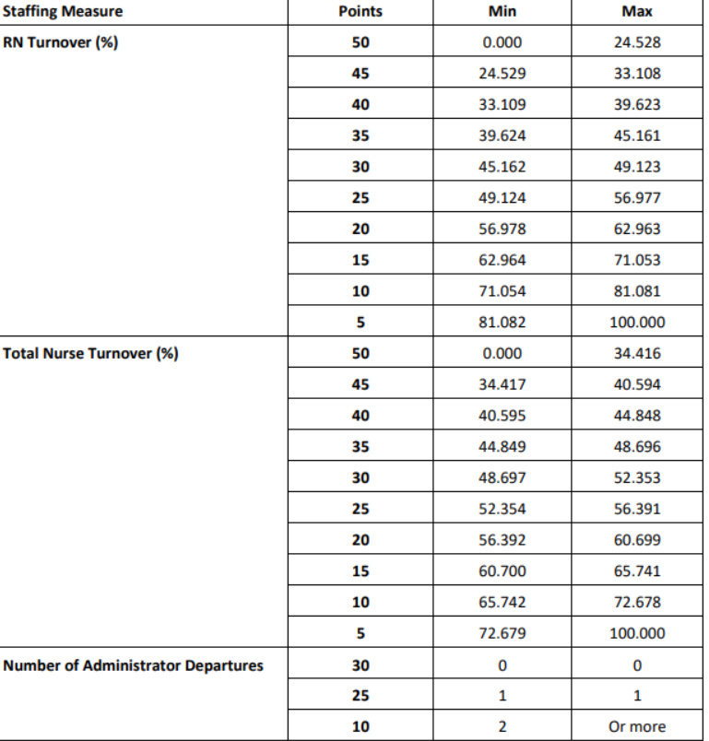

Slide 17
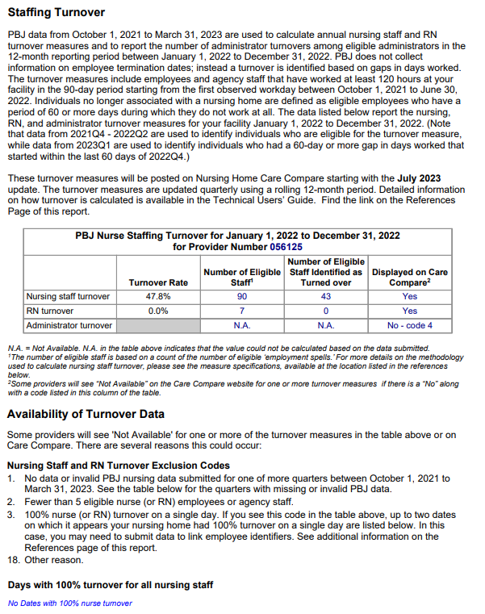
CMS Five Star report turnover sample

Slide 18
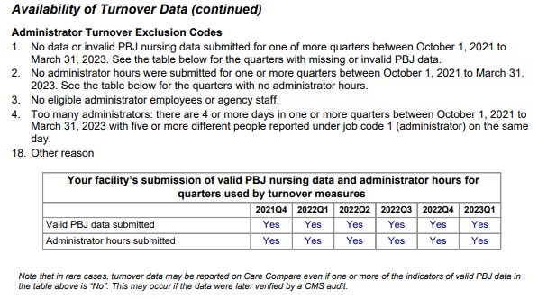
CMS Five Star report turnover sample

Slide 19
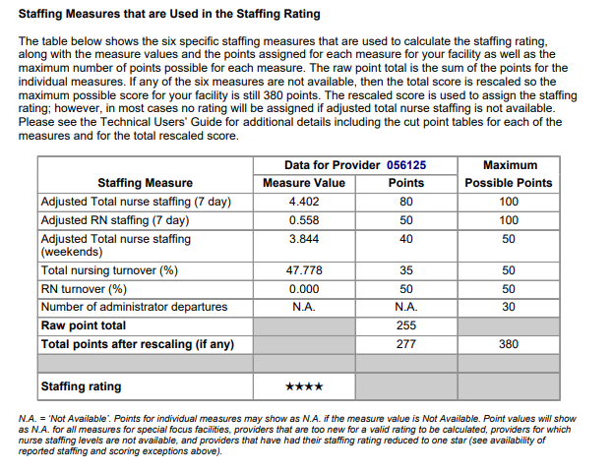
CMS Five Star staffing summary

Slide 20
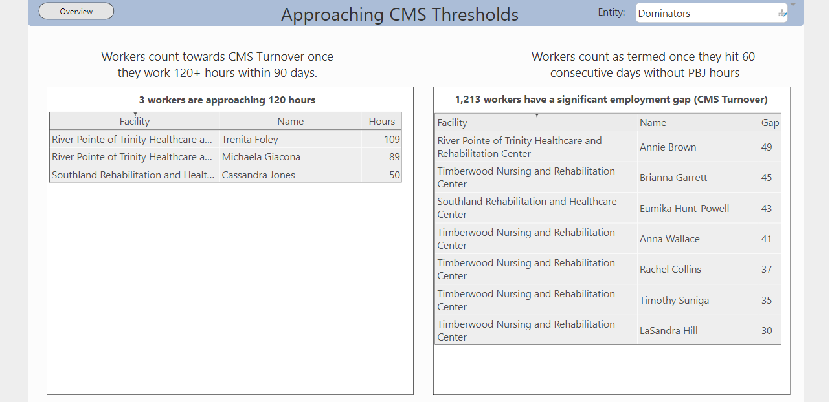
Example of turnover management tool

Slide 21
